Slide 1

DAV Bank Online Banking Services
Project done by:1.Abdul
2.Vishnupriya
3.Deepika

Slide 2
Agenda:
Introduction
Problem Statement
Flowchart
Algorithm
Key Functionalities
Application
Future Scope
Outlooks
Conclusion

Slide 3
Introduction:
What is DAV Bank?
A web-based banking system built using Flask (Python).
Provides users with secure access to banking services.
Key Features:
User authentication (login/signup).
Dashboard for account management.
Chatbot for customer support.
Banking operations (balance inquiry, transaction history, debit, PIN change, etc.).
Contact form for customer queries.

Slide 4
Problem Statement:
Current Challenges:
Lack of user-friendly online banking systems.
Inefficient customer support.
Limited accessibility to banking services.
Solution:
Develop a secure, user-friendly web application.
Integrate a chatbot for instant customer support.
Provide seamless access to banking services.

Slide 5
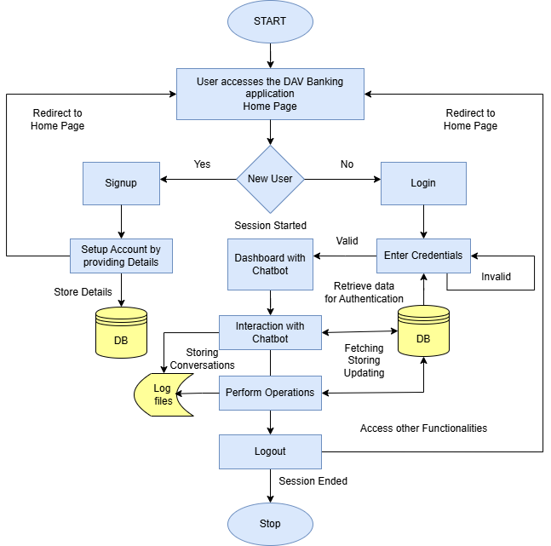

Slide 6
Algorithm:
1.Start
2.User Authentication:
Validate username, password, and account number using regex.
Store user details in the database.
3.Chatbot Interaction:
Capture user input and process it using handle_chatbot_response.
Provide appropriate responses based on the user's query.
4.Banking Operations:
Fetch balance using get_balance.
Retrieve transaction history using get_transaction_history.
Debit account using debit_account and Loan application process.
Change PIN using change_user_pin.
5.Error Handling:
Log errors and display user-friendly messages.
6.End

Slide 7
Key Functionalities:
1. User Authentication:
Signup: User.create_user(email, username, password, account_number).
Login: SELECT * FROM users WHERE username = ?.
2. Chatbot:
handle_chatbot_response(user_id, message).
3. Banking Operations:
get_balance , get_transaction_history , debit_account , change_user_pin.
4. Error Handling:
Logging errors using logging.basicConfig.
5. Session Management:
session[ 'user_id' ], session[ 'username' ], etc.

Slide 8
APPLICATION:
Real-World Applications:
Online banking for customers.
Customer support via chatbot.
Secure transaction management.
User-friendly interface for non-technical users.
2. Industries:
Banking and finance.
E-commerce (payment integration).
Customer service automation.

Slide 9
Future Scope:
Enhancements:
Integrate AI/ML for advanced chatbot capabilities.
Add mobile app support (React Native/Flutter).
Implement two-factor authentication (2FA) for added security.
Enable international transactions and currency conversion.
Integrate with third-party APIs for additional services (e.g., credit score check).
2. Scalability:
Migrate to a cloud-based infrastructure (AWS, Azure).
Use a more robust database (PostgreSQL, MongoDB).

Slide 10
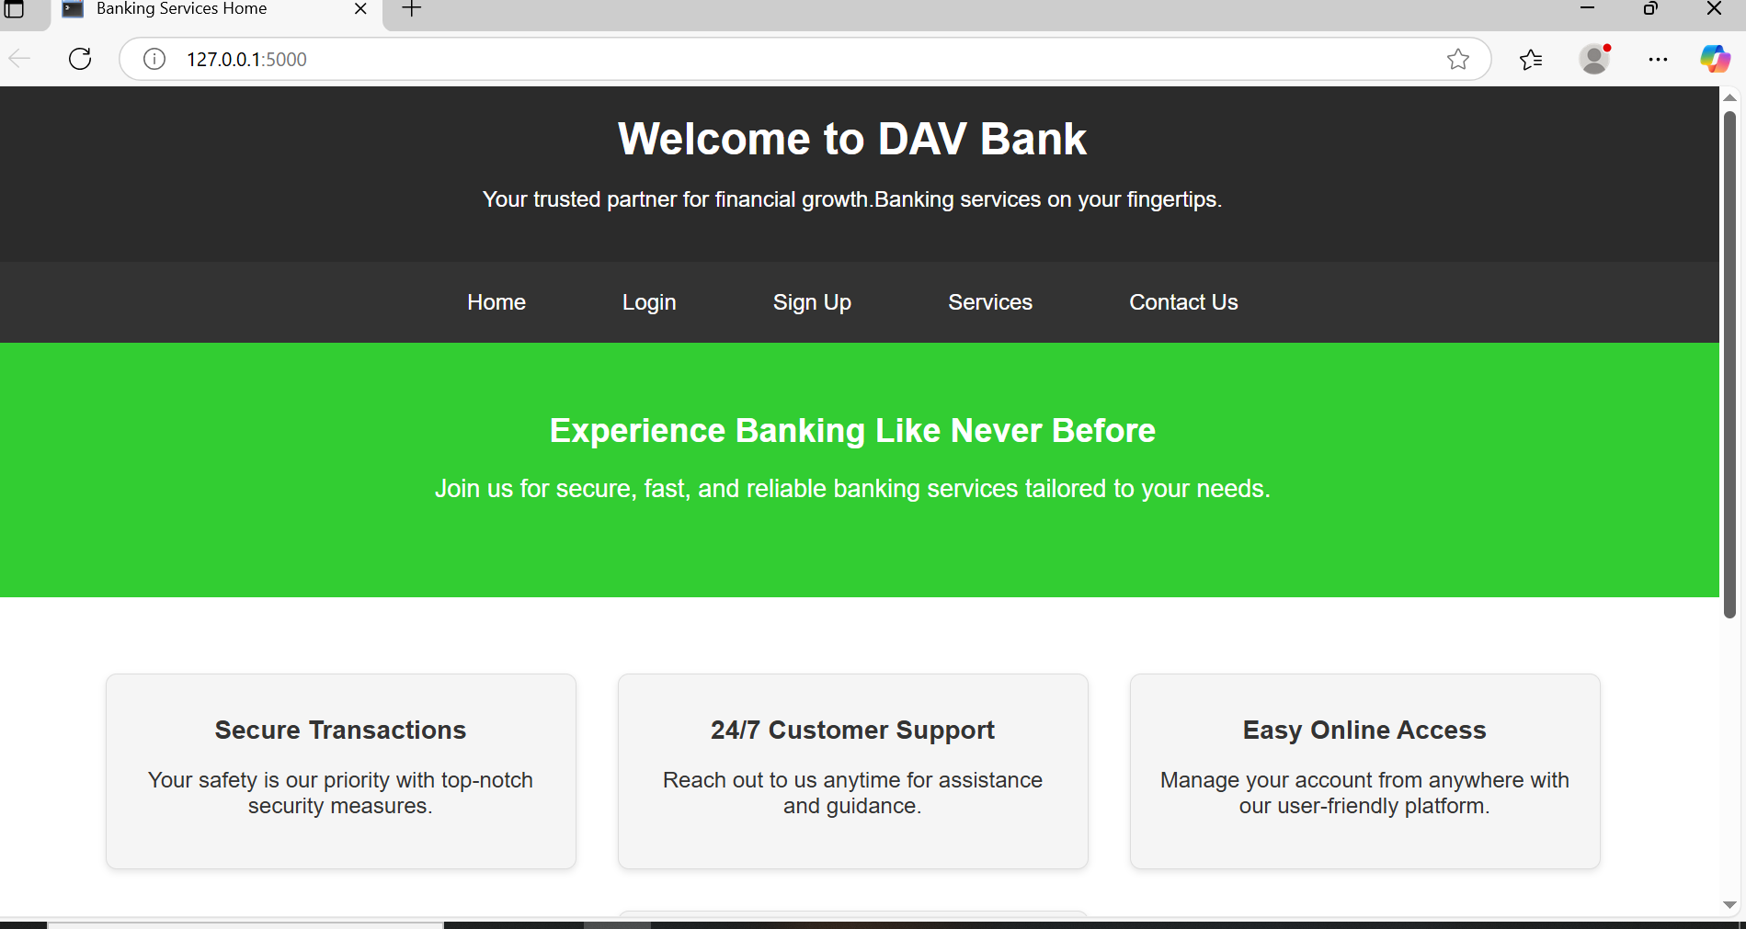
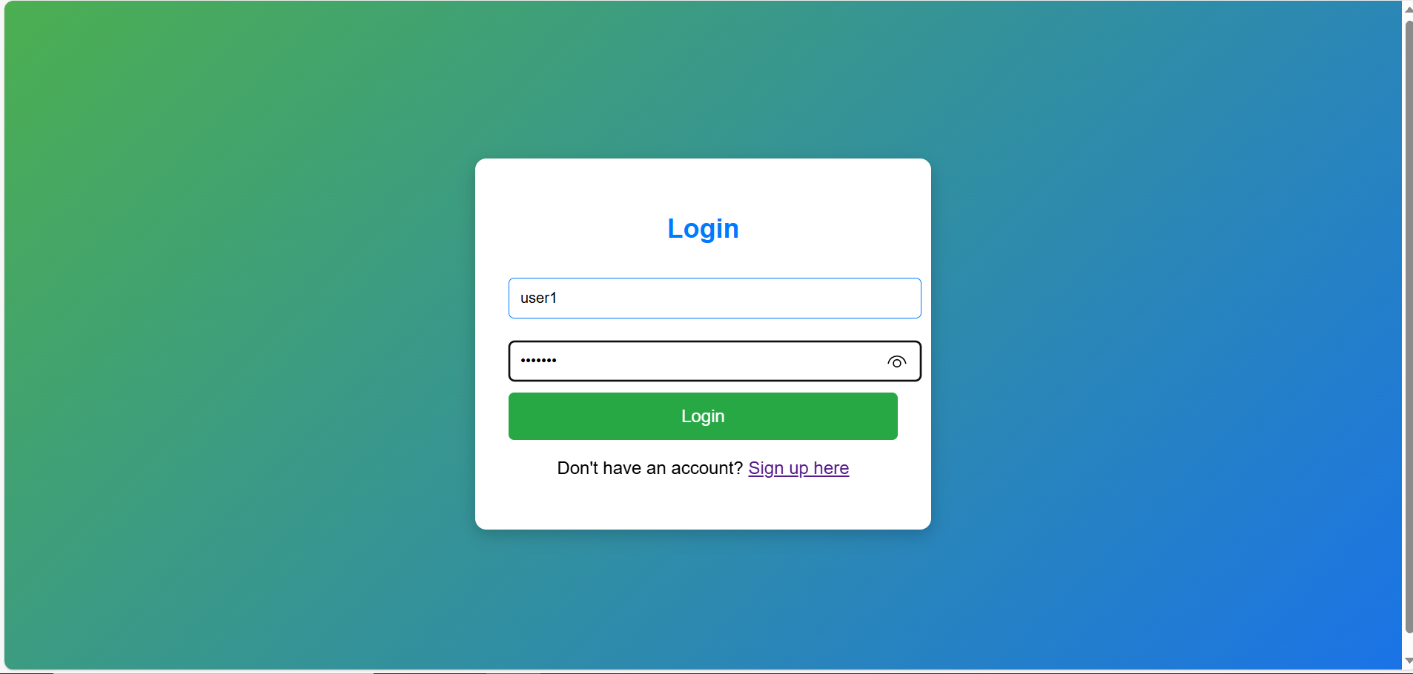
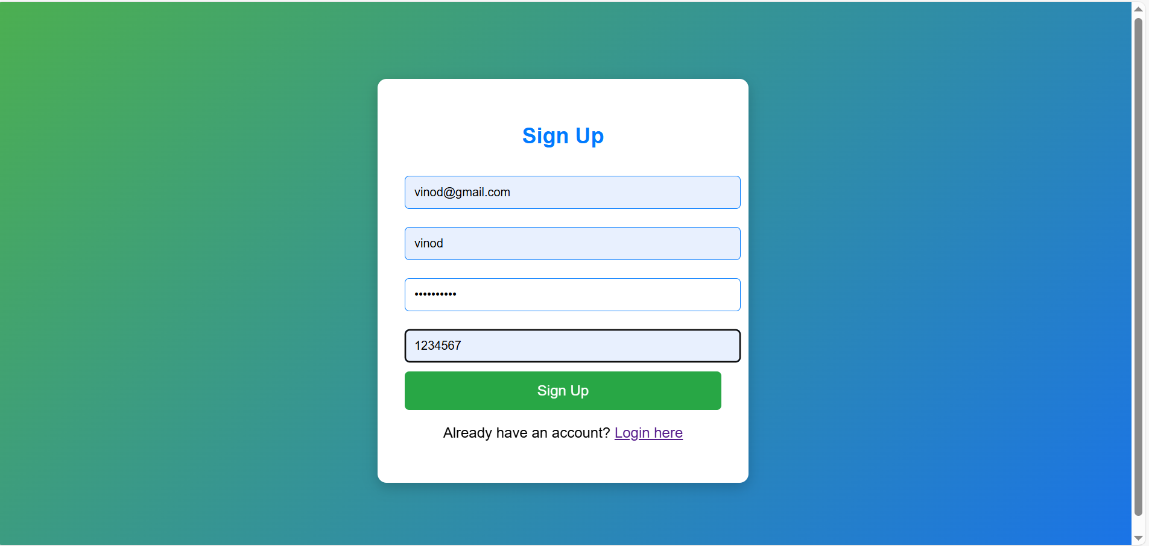
Outlooks: Home pages:
1.Home Page:
Description: This is the landing page of the application.
Navigation links (e.g., Login, Signup, Services, Contact).
A brief description of the application's features.
Purpose: Introduces the application and its purpose to the user.
2. Login Page :
Description: The page where users log in to access their accounts.
Input fields for username and password.
A "Login" button.
A link to the signup page for new users.
Purpose: Demonstrates the authentication process.
3. Signup Page :
Description: The page where new users create an account.
Input fields for email, username, password, and account number.
A "Signup" button.
Validation messages (e.g., for invalid email or password).
Purpose: Highlights the user registration process and input validation.

Slide 11
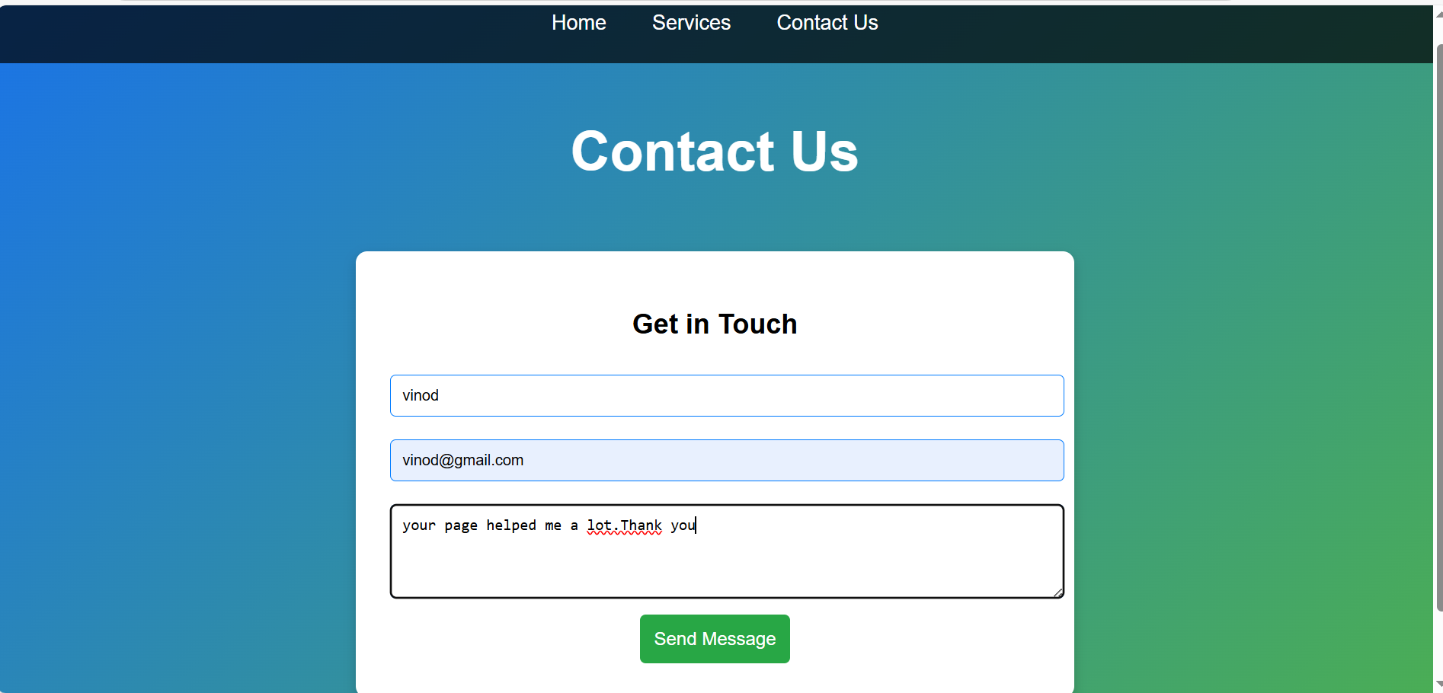
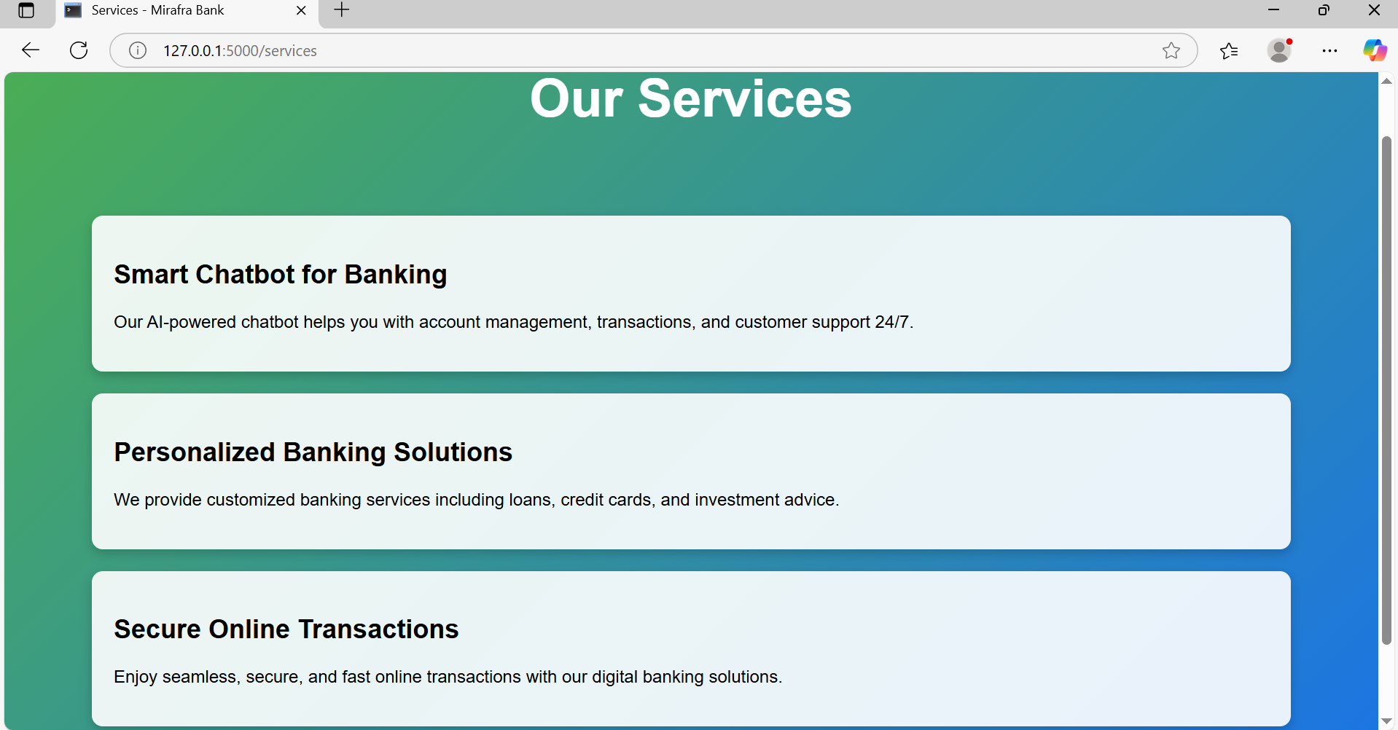
4. Contact Page:
Description: The page where users can submit inquiries or feedback.
Input fields for name, email, and message.
A "Submit" button.
A confirmation message after submission (e.g., "Thank you for contacting us!").
Purpose: Highlights the customer support feature.
5. Services Page:
This page shows services provided by the dav online banking.

Slide 12
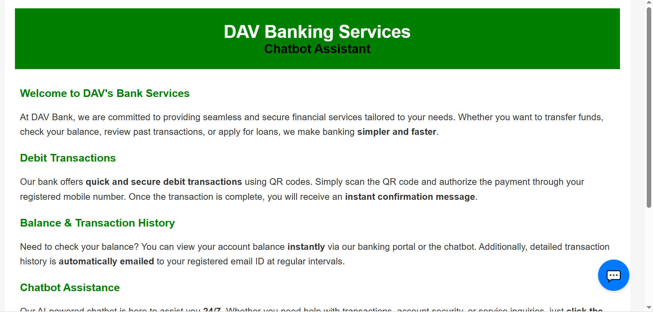
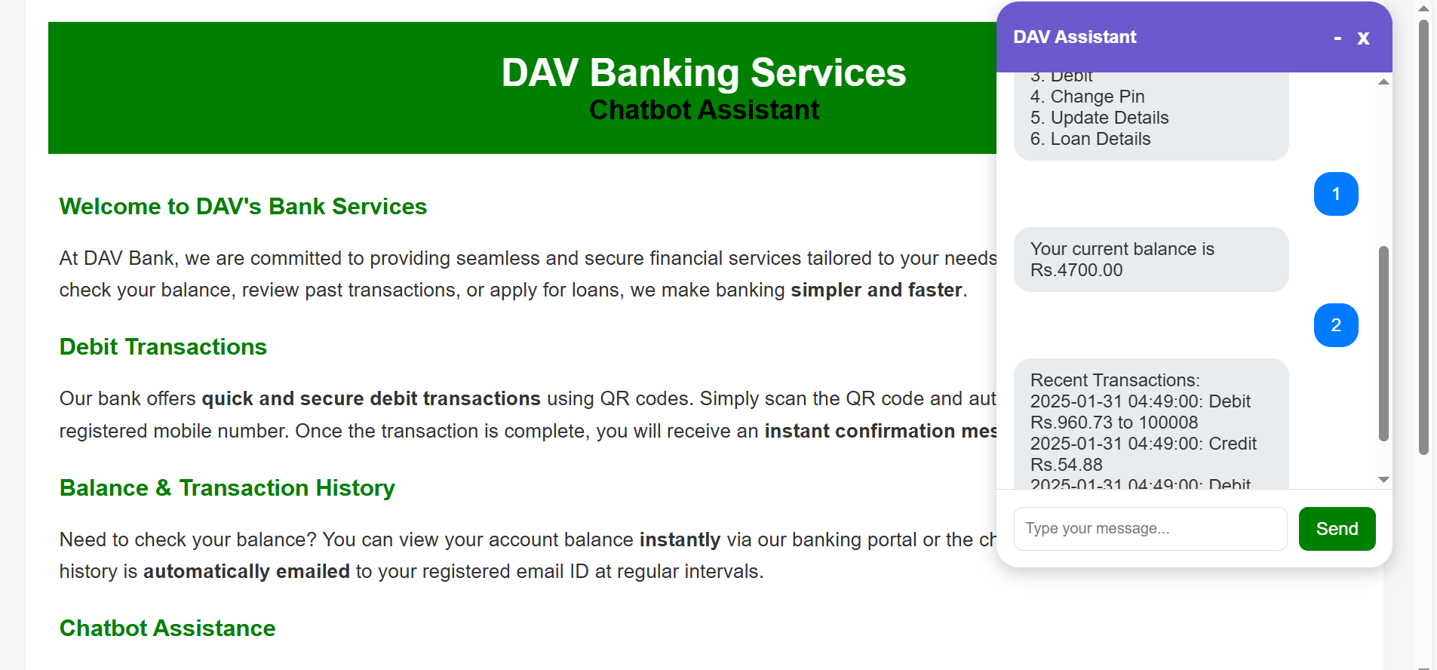
Chatbot Working:
1. Dashboard :
Description: The main interface after a user logs in.
A welcome message with the user's name.
Options to check balance, view transaction history, debit account, change PIN, or interact with the chatbot.
A logout button.
Purpose: Shows the central hub for accessing banking services.
2. Chatbot Interface:
Description: The interactive chatbot for customer support.
A chat window with sample user queries and bot responses.
Example: User types "Hello," and the bot responds with "Welcome to DAV Bank! How can I assist you today?"
Purpose: Demonstrates the chatbot's functionality and user interaction.

Slide 13
Conclusion:
The DAV Bank Online Banking System is a secure and efficient web application designed to simplify banking operations and improve user experience. With features like user authentication, account management, and an interactive chatbot, it ensures seamless access to essential banking services. Built using Flask, the application emphasizes security, scalability, and user-friendliness. This project highlights the potential of modern web technologies to create innovative and reliable banking solutions for the future.

Slide 14
THANK YOU

